Slide 1

[Samsung PRISM] Preliminary Discussion
Deep Cache Implementation
Team
College Professor(s):
Dr. G.K.Sandhia / sandhiag@srmist.edu.in
Dr.D.Viji / vijid@srmist.edu.in
Students:
Abhishek Soni / as8819@srmist.edu.in
Arnav Agarwal / aa5579@srmist.edu.in
Devanand K / dk7180@srmist.edu.in
Kushagra Saxena / ks3780@srmist.edu.in
Department: CTECH
Date: 6th May 2024

Slide 2


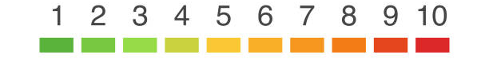

DeepCache Implementation
Problem Statement
Expectations
Context
Undertaken Tasks
Conduct Literature survey.
Implement DeepCache.
Identify whether LoRA technique post DeepCache implementation is feasible and helps in getting more inference time.
DeepCache helps improve inference speed of Stable Diffusion model. It does this by skipping few steps in U-Net during inference. The results are faster with very little degradation in quality. We can have this worklet to compare this method as well as combining this with other methods to improve inference speed of SD.
KPI
DeepCache implementation
Inference speed should have at least 25% improvement for similar prompt on vanilla Stable Diffusion model.
LoRA implementation.
Statement
Implement DeepCache on latest Stable Diffusion model.
Worklet Details
Mentors
Pranal Prasad Dongare
+91-7022250561
pranal.p@samsung.com
6
4
Timeline
Tushar Madaan
+91-9205301569
Tushar.m2@samsung.com
Kick Off < 1st Month >
Milestone 1 < 3rd Month >
Milestone 2 < 6th Month>
Duration (Months)
Members Count
Problem Briefing
Check Feasibility
Literature Survey
LLM Setup
Initial implementation of architecture.
Initial benchmarking of performance.
Optimization and enhancement of implemented model.
Pre-Requisite
2312.00858.pdf (arxiv.org)
Complexity
Notes:
https://nv-tlabs.github.io/DIB-R/

Slide 3
Work-let Name: DeepCache Implementation
Worklet Details
Worklet ID: 23GAI30
College Name: SRM Institute of Science and Technology
Last Meet’s Progress
Last month, our team focused on understanding the core concepts outlined in the project worklet.
We delved into implementing DeepCache in diffusion models and exploring LoRA technology integration.
Key milestones achieved include:
Gaining familiarity with project terminology.
Establishing a foundational understanding of the project scope.
These milestones signify significant progress and set the stage for upcoming tasks.
Date: 6th May 2024

Slide 4
Stable Diffusion Model:
The Stable Diffusion (SD) model is a type of generative model used in machine learning for image generation. It is designed to generate high-quality images by modelling the data distribution in a probabilistic way. The key idea behind diffusion models is to transform a simple noise distribution into the desired data distribution through a series of steps. The "diffusion" refers to the gradual transformation of the noise into the desired data, and stability is introduced to ensure robustness in the training process.
In the context of image generation, the SD model uses a diffusion process to iteratively refine an initial noise signal until it converges to a realistic image. This process involves a series of steps, making it computationally intensive, especially during the inference phase. Approaches like DeepCache aim to improve the inference speed of such models by optimising certain steps.
DeepCache in Stable Diffusion Model:
DeepCache is a new way to speed up diffusion models used in image synthesis without needing to retrain them. It works by saving and reusing certain parts of the model as it processes images, which reduces the need for repetitive calculations. By doing this, DeepCache makes diffusion models run faster while maintaining similar quality results. It's shown to be better than other methods like pruning and distillation that require retraining.
DeepCache is a technique designed to speed up the inference process in diffusion models by leveraging the redundancy present in consecutive steps of the reverse diffusion process. It draws inspiration from the caching mechanism used in computer systems, where frequently accessed data is stored for quick retrieval, thus reducing the need for repeated calculations.

Slide 5
Working of DeepCache in SD Model:
Utilising Skip Connections: DeepCache focuses on the skip connections within the U-Net architecture, which offers a dual-pathway advantage. The main pathway requires heavy computation to traverse the entire network, while the skip pathway only needs to go through shallow layers, resulting in a much lower computational load.
Caching Features: DeepCache identifies features within the diffusion process that change slowly over time. These features are cached, meaning they are stored for later use rather than being recalculated in subsequent steps.
Dynamic Inference: During the inference process, DeepCache dynamically decides which parts of the network need to be recalculated and which parts can be retrieved from the cache. This reduces redundant computations, especially in regions where the features change slowly.
Partial Inference: Instead of performing a full inference at each step, DeepCache performs partial inference by recalculating only the necessary parts of the network and retrieving cached features for the rest. This significantly speeds up the process while maintaining accuracy.
Extending to Multiple Steps: DeepCache can be extended to cover multiple consecutive steps of the diffusion process. Cached features are reused across these steps, reducing computational overhead further.
Overall, DeepCache optimises the inference process in diffusion models by strategically caching features and dynamically adjusting the computation load. This results in faster inference times without sacrificing the quality of the output.
LoRA Implementation:
LoRA is a technique designed to improve the training of deep neural networks by aligning the local ranks of samples in the feature space. It focuses on capturing and aligning the local relationships between samples, aiming to enhance the discriminative power of the learned representations. This technique is often applied in the context of image classification and feature learning.

Slide 6
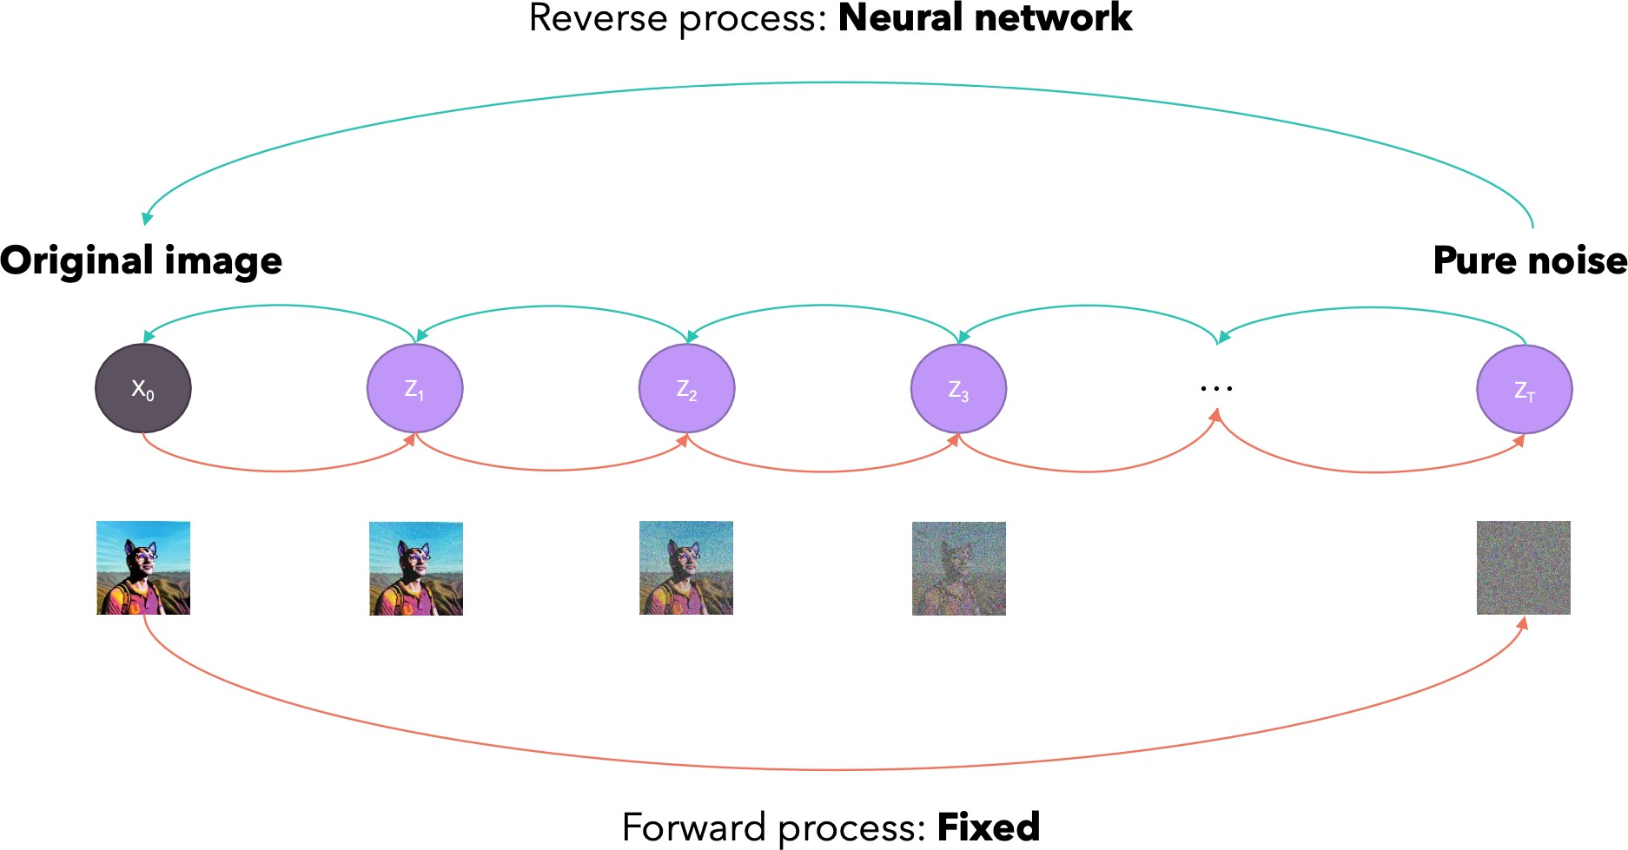
Image Generation through Noise

Slide 7
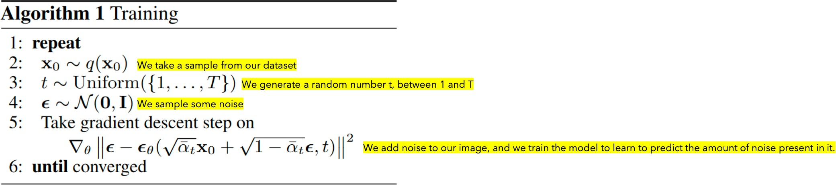
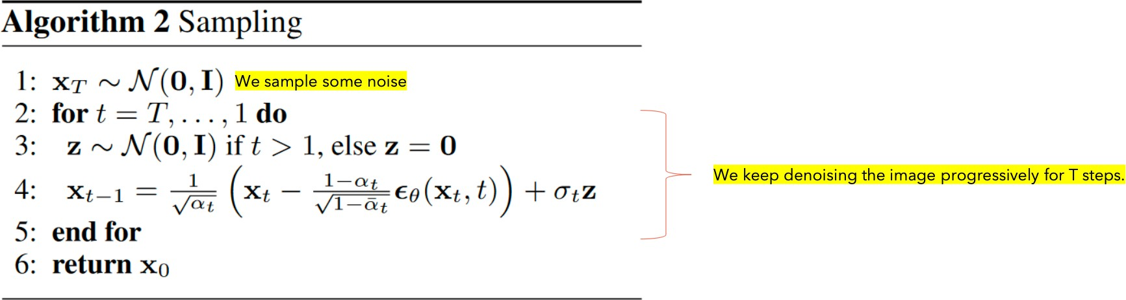
Mathematical Algorithm of SD model

Slide 8
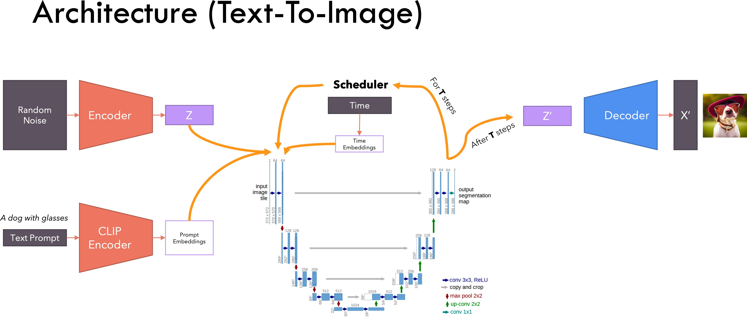
Architecture for SD Model

Slide 9
Components
Scheduler: This component manages the overall training process, likely coordinating the flow of data and ensuring other parts work together.
Text Prompt: This refers to the input text description that the system will use to generate an image.
Encoder: This block takes the text prompt and converts it into a machine-readable representation, like a vector of numbers.
Embeddings: This represents the process of converting textual information into numerical vectors. It’s a way for the model to understand the meaning of the words in the text prompt.
Noise: Random noise is introduced at this stage, which helps the model produce more diverse and creative outputs during image generation.
Decoder: This block takes the encoded text representation and the noise, and uses them to generate an image. It essentially learns to translate the encoded text into a corresponding image.
CLIP: This stands for Contrastive Language-Image Pre-training. It’s a model that has been trained on a massive dataset of text-image pairs. It’s likely used to compare the generated image with the encoded text description to ensure they align.
Conv 3x3, no linear: This refers to a convolutional layer with a kernel size of 3x3 and no linear activation function applied. Convolutional layers are essential for image recognition tasks; they help identify patterns in the image data.
Max Pool 2x2: This layer performs downsampling, reducing the dimensionality of the image data by taking the maximum value from a 2x2 window.
Up-sample 2x2: This layer increases the resolution of the image data by a factor of 2 in each dimension (width and height).
Com 3x3, no linear: This refers to another convolutional layer with a kernel size of 3x3 and no linear activation function applied.

Slide 10
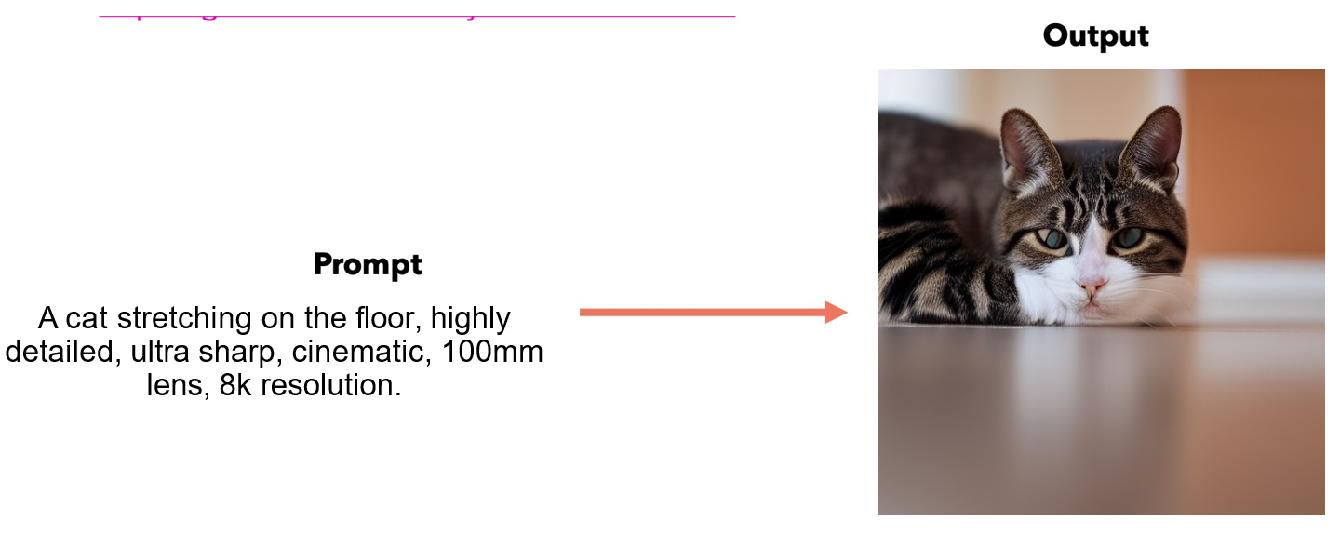
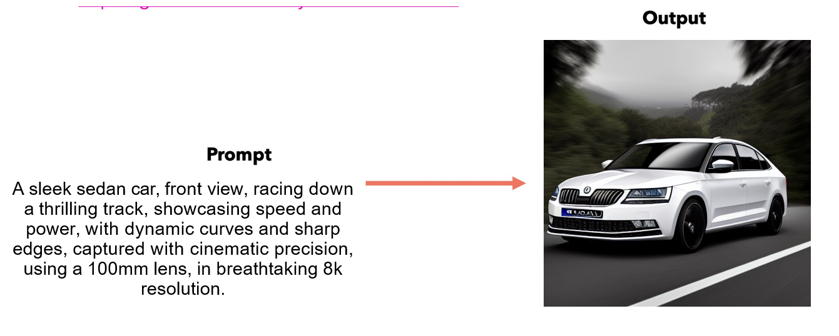
Results

Slide 11
Work-let Name: DeepCache Implementation
Worklet Details
Worklet ID: 23GAI30
College Name: SRM Institute of Science and Technology
Successfully developed Stable Diffusion Model required.
Successfully generated images using the text to image SD-model.
Completion of Deep Cache analysis and coding.
Theoretical stand base for LoRA implementation analysis.
One of the primary challenges we encountered was that the we needed high performance laptop .
Our current devices are taking too long to generate images.
KPIs achieved till now
Any Challenges/ Issues faced
Next Steps
Integration of Deep cache in the SD model.
Implementation of LoRA over SD model combined with Deep cache and analysing its feasibility in inference time.
Successful implementation of stable diffusion model .
Generation of high quality images through descriptive prompts given by the user.
Key Achievements/ Outcome till now
Date: 6th May 2024

Slide 12
Thank you

